Slide 1

IDESIGN
From 50,000 Feet

Slide 2

IDesign
Developed by Juval Lowy
Principal of IDesign
Architect
Written books
Recognized Software Legend by Microsoft
Training

Slide 3
IDesign – What is it?
No Formal Definition
My interpretation based on many videos and training (DPL)
Set of ideas or processes to guide the architecture and design process of adaptable software.
Created this process out of an idea:
“Every business problem, regardless of the specifics, you should be able to create a process or method to decompose a system and then the rest of the design process can be mechanized.”¹

Slide 4
Traditional Decomposition Methodologies
Functional Decomposition
“If the business process is to do A, then do B, then do C. Then we write an A service, a B service and a C service.”¹
Trading Web Portal
Buying Stocks
Trade Scheduling
Reporting
Selling Stocks
Feed Processing
Analyzing
Trades DB
Reports DB

Slide 5
Traditional Decomposition Methodologies
Object Oriented Decomposition
Designing by identifying data and procedures that can be grouped together to represent an entity.
Trading Web Portal
Customer
Stock
Report
Feed
Trades DB
Customers DB
Reports DB

Slide 6
Flaws with these Methodologies
Functional
When requirements change, so do your set of services and the order they are called in.
Services always do more than just A, B and C so services become bloated (ex Policy validation).
Couples the design to the current set of use cases.
Change is highly disruptive
Object Oriented
Good in theory but difficult in practice.
Goals are similar to IDesign but getting there is more difficult.

Slide 7
IDesign Methodology
Look for change (“Areas of Volatility”)
Where can the system change?
Encapsulate the areas of change into services.
Come up with the core set of use cases and design for those.
While you may have hundreds of use cases, usually most use cases are variations of a core set of 5 or 6 use cases.
Provides a basic way to document a system.

Slide 8
IDesign Methodology – Finding Areas of Change
Go to your product owner and say, “If this system could only do one thing, what would it be.” ¹
Design for this.
Go back to the product owner and say, “If the system could only do one more thing, what would it be.”¹
Make sure this isn’t just a variation of the first thing.
If it is truly something different, design for it.
5 or 6 iterations should lead you to a “good” design.

Slide 9
IDesign Methodology
Feed A
Feed B
Feed C
Trading Web Portal
Trade Workflow
Analysis Workflow
Notification
Feed Transformation
Trades Access
Workflow Access
Customer Access
Trades
Storage
Workflow
Storage
Customer
Storage

Slide 10
Functional
Object Oriented
IDesign
Trading Web Portal
Feed A
Feed B
Feed C
Trading Web Portal
Trading Web Portal
Buying Stocks
Trade Scheduling
Reporting
Trade Workflow
Analysis Workflow
Notification
Feed Transformation
Customer
Stock
Report
Feed
Selling Stocks
Feed Processing
Analyzing
Trades DB
Customers DB
Reports DB
Trades Access
Workflow Access
Customer Access
Trades DB
Reports DB
Trades
Storage
Workflow
Storage
Customer
Storage

Slide 11
IDesign - Documentation
House Analogy
When building a house, how many views of the house are there?

Slide 12
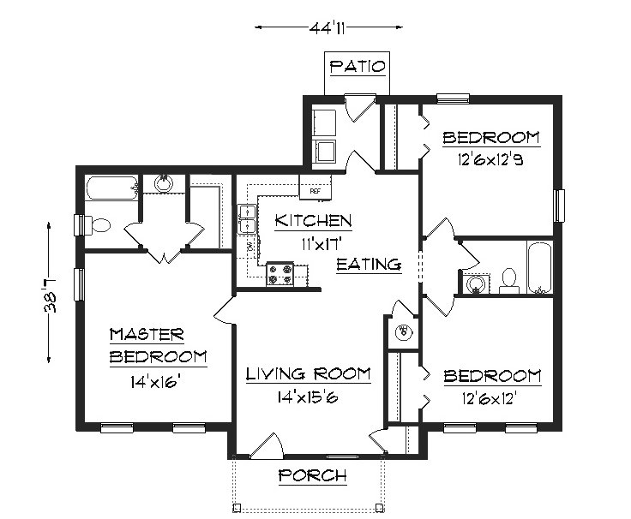
IDesign – House Analogy
Structure Diagram

Slide 13
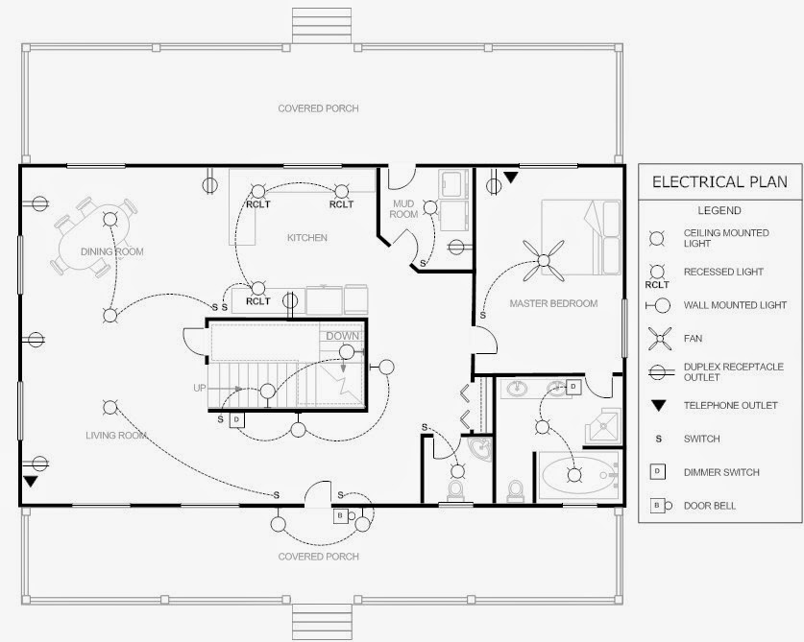
IDesign - House Analogy
Electrical Diagram

Slide 14
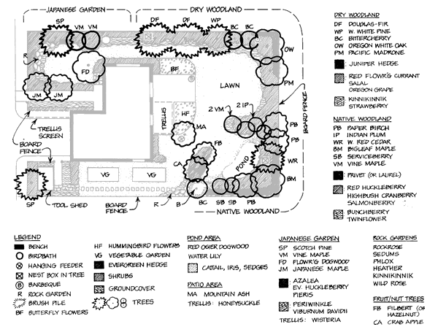
IDesign - House Analogy
Landscape Diagram

Slide 15
IDesign - Documentation
Client
Basic abstractions:
Clients: Website, WebAPI, UI
Managers: Manages sequence of actions
Engines: Applies algorithms and business rules
Accessors: Access Data and resources
Resources: Data storage or data retrieval points
Utilities: Span all
Manager
Engine
Accessor
Resource
Utility

Slide 16
IDesign - Rules
Client
Services can only call down
Except for utilities.
Following are not allowed:
Manager to Manager (synchronously)
Client to Engine
Client to Accessor
Manager
Engine
Accessor
Resource
Utility

Slide 17
IDesign Diagrams
Flow Diagram (Call Chain)
Defines a set of services and interactions to satisfy a unique activity.²
Show the interaction but does not show the sequence or order of events.²

Slide 18
Simple Flow Diagram – Place a trade²
Website
Trade Manager
Trade Accessor
Trades

Slide 19
More Complex Flow Diagram – Analyze Scheduled Trades²
Background Service
Analysis Manager
Notification Manager
Pricing Engine
Pricing Accessor
Trade Accessor
Feed Data Accessor
Pricing
Trades
Feed Data

Slide 20
IDesign Diagrams
Flow Diagram (Call Chain)
Defines a set of services and interactions to satisfy a unique activity.
Show the interaction but does not show the sequence or order of events.
Static Diagrams
One diagram that shows all the Clients, Managers, Engines, Accessors, Utilities and Resources of a system in one diagram. All flow diagram pieces.
Shows the “structure” of your system.

Slide 21
Sample Static Diagram – Trading System²
Utilities
Security
Client
Website
Background Service
Logging
Trade Manager
Analysis
Manager
Notification Manager
Feed Manager
Business Logic
Email Engine
Pricing Engine
Resource Access
Pricing Accessor
Trade Accessor
Feed Data Accessor
Email Accessor
Data
Pricing
Trades
Feed Data
SMTP Service

Slide 22
IDesign Diagrams
Flow Diagram (Call Chain)
Defines a set of services and interactions to satisfy a unique activity. ²
Show the interaction but does not show the sequence or order of events. ²
Static Diagrams
One diagram that shows all the Clients, Managers, Engines, Accessors, Utilities and Resources of a system in one diagram. All flow diagram pieces.
Shows the “structure” of your system.
Other
Requirements/User Story Spreadsheet
Security Diagrams – Similar to flow diagrams but show points of security checks.

Slide 23
Demo/Samples

Slide 24
Reasons I like IDesign
Over time it should be easy for anyone who has used this process to get comfortable in understanding a project design quickly.
Code is typically similarly laid out.
Naming is familiar.
Ramp up time is decreased when moving developers onto a project.
In theory, coding modifications for requirements changes should be decreased.
Faster delivery
It makes sense.
Listen to Juval’s videos. He does a very good job of explaining reasons behind his method and he uses sound reasoning.

Slide 25
Reasons I struggle with IDesign
Identifying areas of volatility is not intuitive.
Decomposing systems using this method can be a struggle at first. I HOPE it gets easier over time.

Slide 26
Resources
Interview: Juval explains the IDesign Method
Don’t Panic Labs slides
Zen of Architecture
A Modular Approach to Development Process
You Tube IDesign Channel
IDesign Website

